Slide 1

M S D S 6 9 7 | S P R I N G 2 0 2 4 | G R O U P 1 6
Automated Data Pipeline: Job Recommender Engine
Shagun Kala | Param Mehta | Belinda Ong
Sonal Shad | Laila Zaidi

Slide 2

Introduction
What we are solving for: Job seekers have to spend a lot of time searching multiple job titles and reading through individual job descriptions to understand if it is a good fit.
Solution: Personalized Job Recommender for Data Scientists.
Automated data pipeline retrieves, processes, and stores daily job posts.
User selects filters and submits resume.
Resume is parsed, text is matched against job descriptions.
Top three matches are displayed with LLM-based summaries of descriptions.

Slide 3
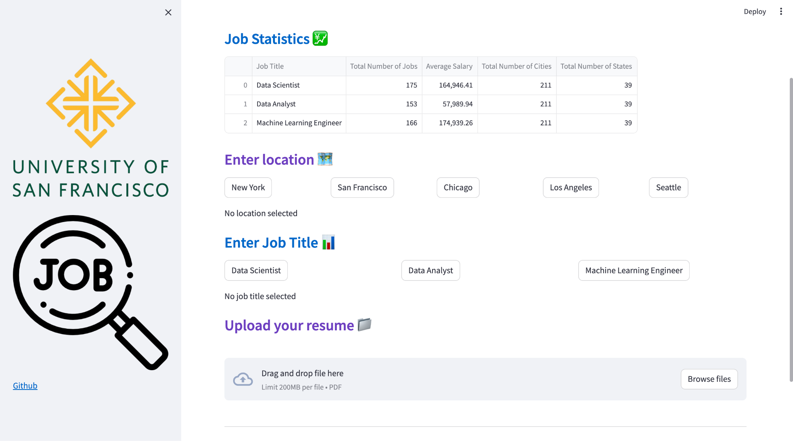
User Interface via Streamlit
Notes:
Front end through Python

Slide 4












Overview of Data Pipeline
API
User Input: Resume, preferred location, and title
Job Recommendations

Slide 5
Overview of Data Pipeline
Use Airflow to request job data from API in JSON format
Run the whole airflow pipeline in Google Cloud
API
Upload the data into Google Cloud Storage
User Input: Resume, preferred location, and title
Job Recommendations
Notes:
We are using Airflow to orchestrate the top 3 steps of the pipeline. It is pulling JSON files from the Rapid API which we store in Google Cloud.

Slide 6
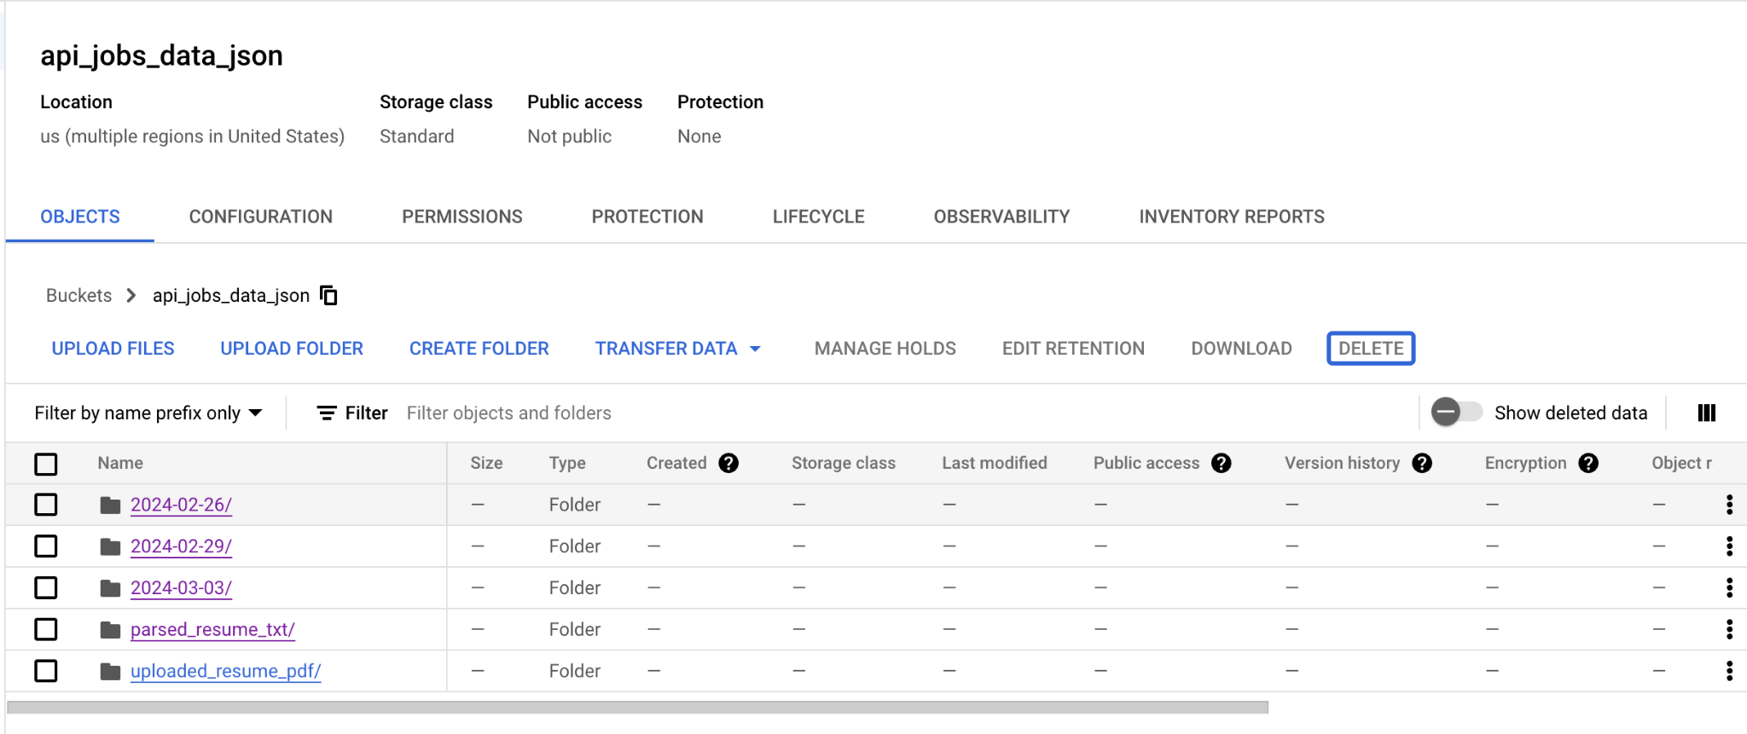
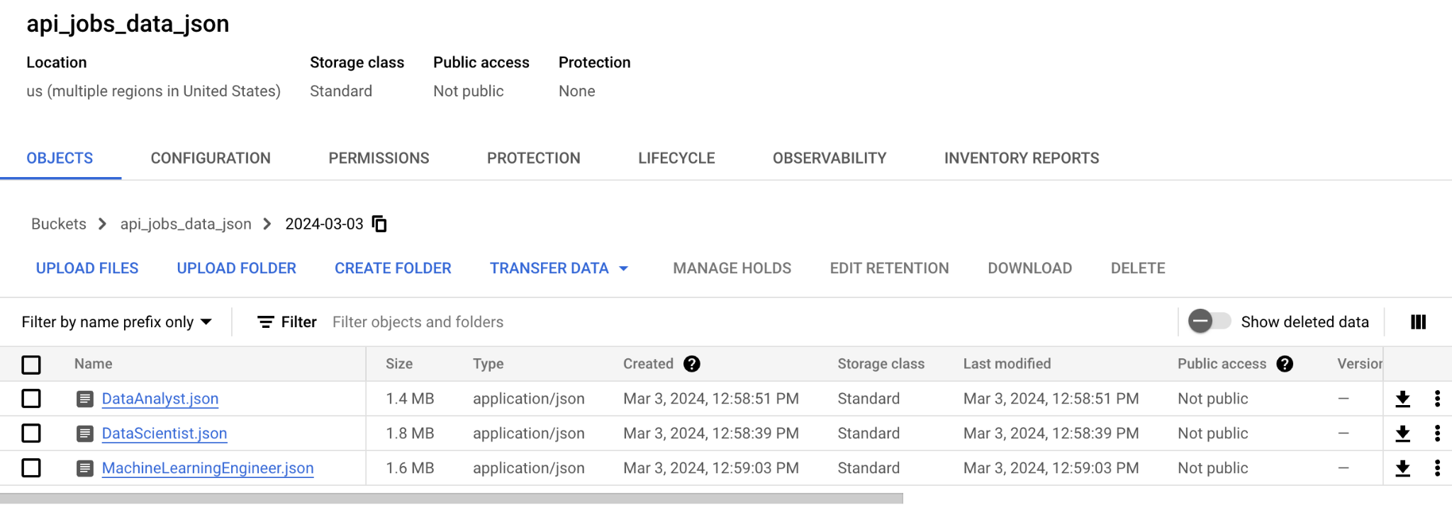
Usage of Google Cloud Storage
Airflow will submit a request to the Rapid API every day and stores the JSON files in a new folder by date, then by job title
Notes:
This is what the data looks like in GCS

Slide 7
Overview of Data Pipeline
Create a MongoDB Atlas cluster
API
Retrieve from GCS, clean using Spark, then store as collections in MongoDB
User Input: Resume, preferred location, and title
Job Recommendations
Notes:
Since JSON is unstructured and from multiple sources so there is no fixed schema, we store it in NoSQL database, MongoDB. We convert these JSON files into MongoDB collections using Spark in a parallel, distributed computing manner since it is so large. Then we store it as a collection in MongoDB

Slide 8
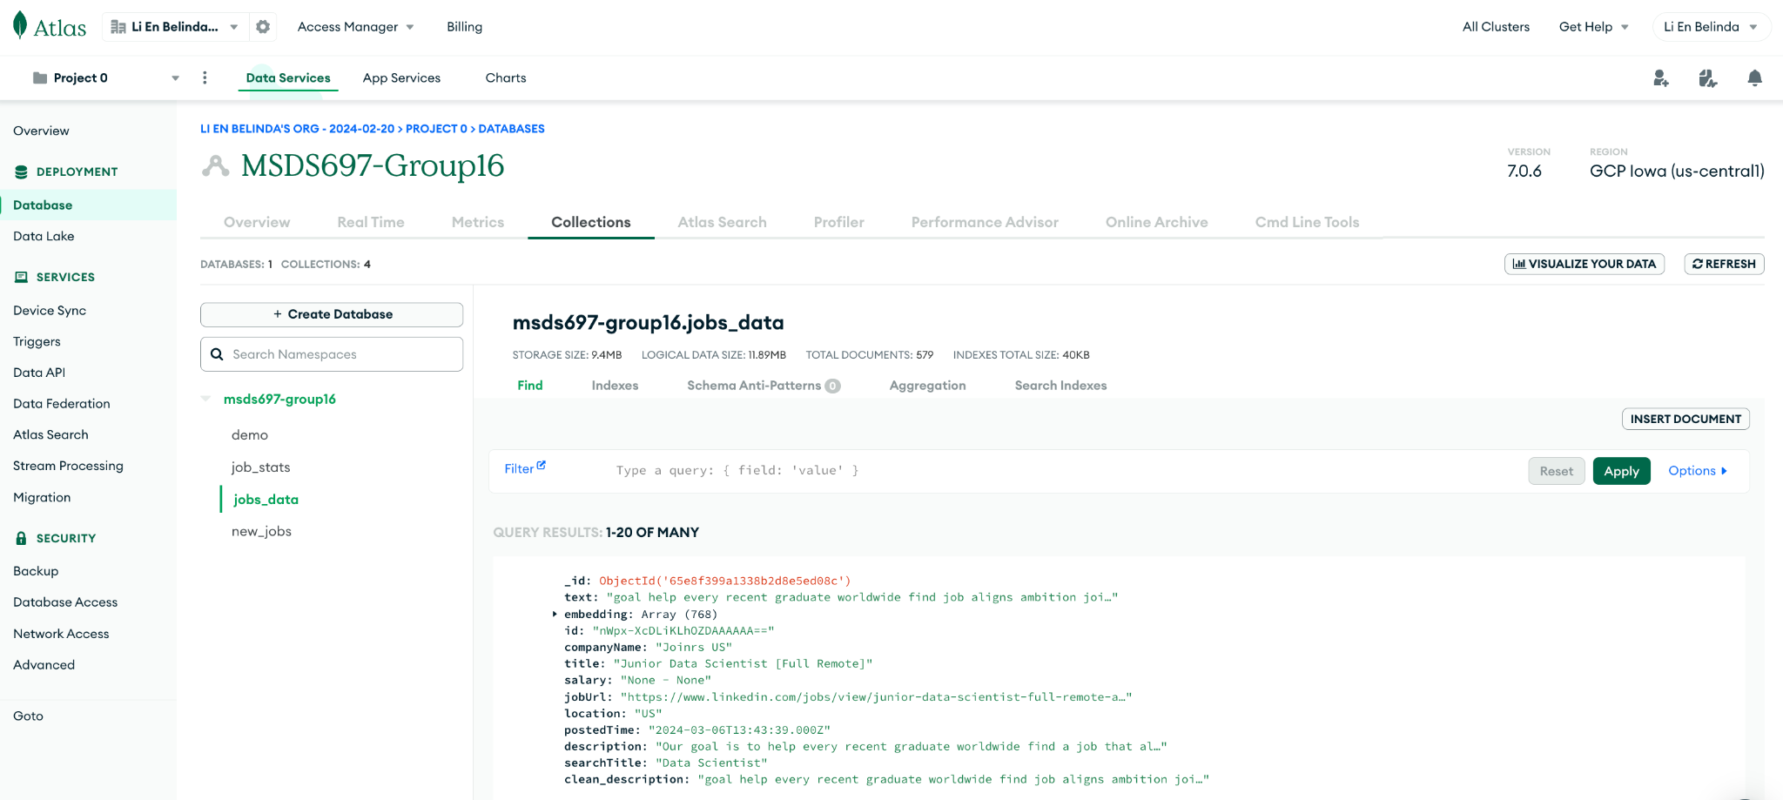
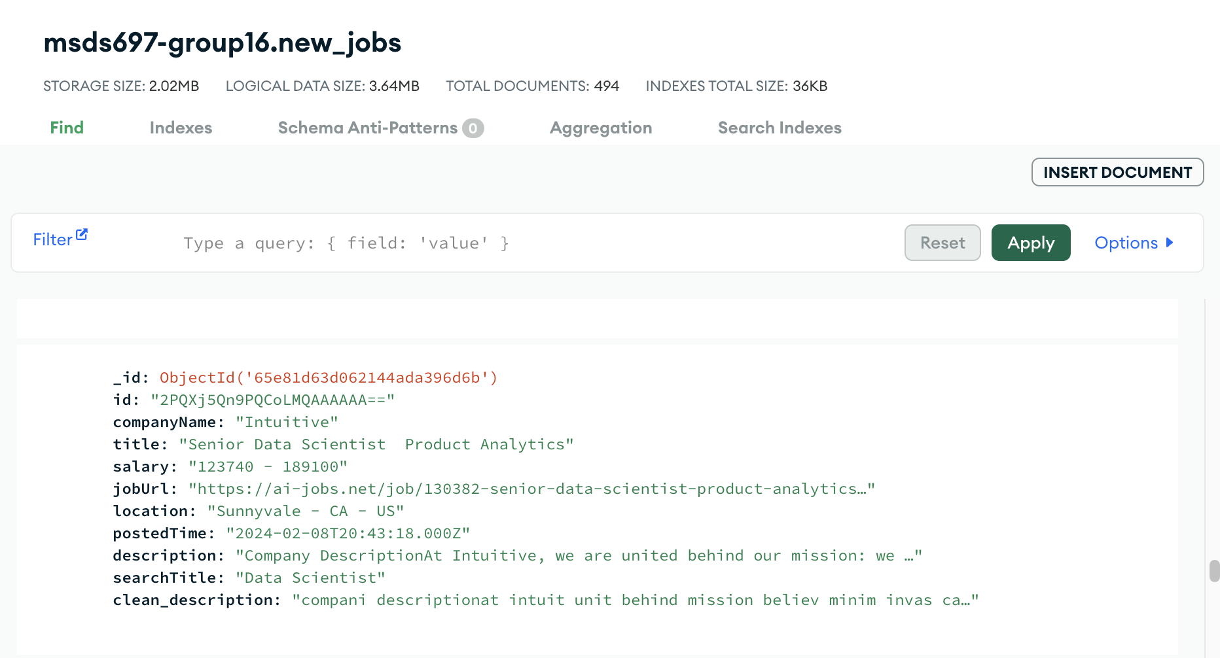
Usage of MongoDB
Notes:
This is what the collection in MongoDB looks like with the job data in the cluster

Slide 9
Overview of Data Pipeline
Create new aggregated dataframes using PySpark and store in MongoDB
API
User Input: Resume, preferred location, and title
Job Recommendations
Notes:
We then aggregate the data to generate summary statistics and saving it as a new collection within MongoDB

Slide 10
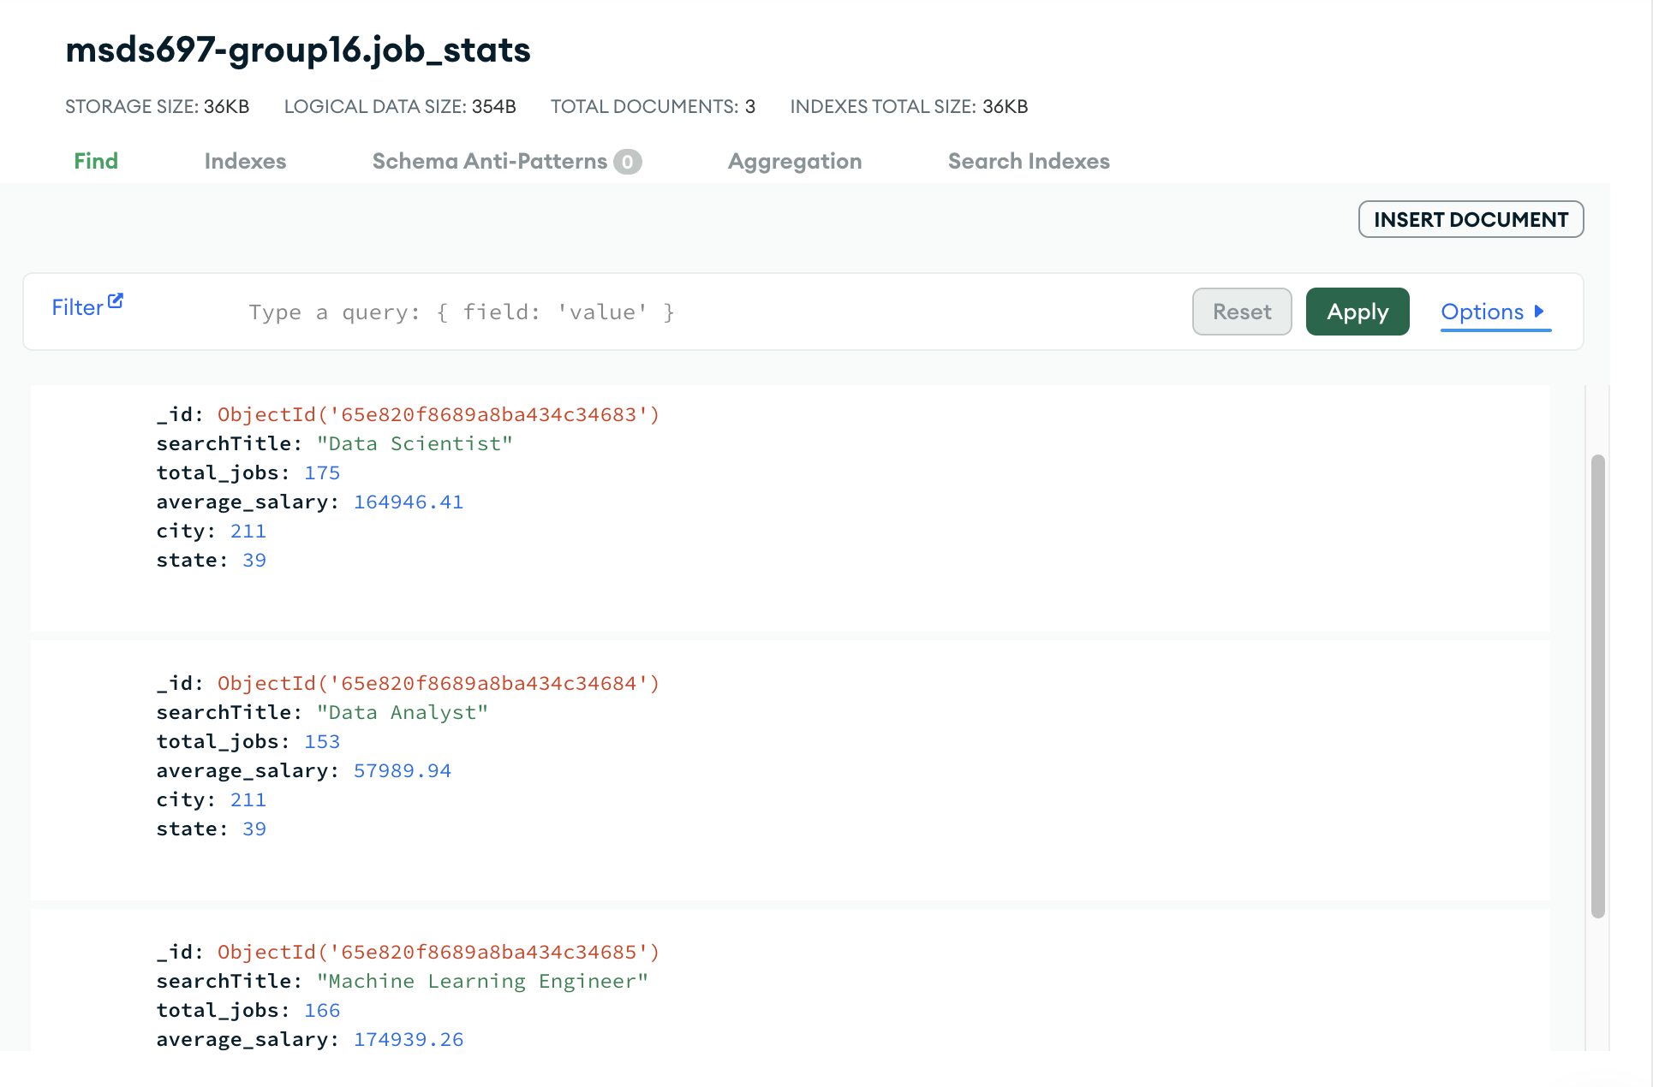
Usage of MongoDB
Notes:
This is what the summary statistics collection looks like on both MongoDB and Streamlit. It covers three data science related job titles, 39 states and 211 cities.

Slide 11
Overview of Data Pipeline
Using the embeddings key, and filtering on the job title, run cosine similarity to determine the closest match jobs to display
API
User Input: Resume, preferred location, and title
Job Recommendations
Notes:
Going back to the user interface, we use Cloud Vision API to extract text from the resume uploaded and generate embeddings from it. We then match it against the embeddings from the stored job descriptions in MongoDB using Cosine similarity. The output is then displayed in the Streamlit UI.

Slide 12
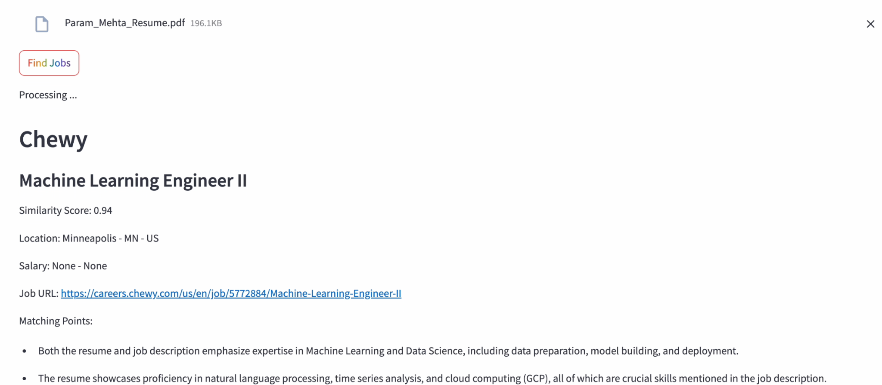
Displaying the recommendations
Notes:
The matching points here are synthesized using Gemini and explains how the resume is a match to the job description. Therefore, Param should go for this Machine Learning Engineer role

Slide 13
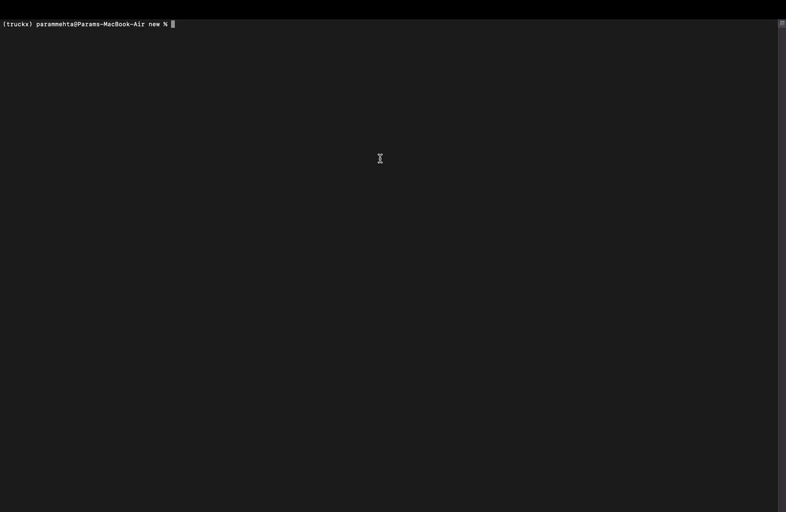
Demo
Github
Code base and project report

Slide 14
M S D S 6 9 7 | S P R I N G 2 0 2 4 | G R O U P 1 6
Automated Data Pipeline: Job Recommender Engine
Shagun Kala | Param Mehta | Belinda Ong
Shnal Shad | Laila Zaidi

Slide 15
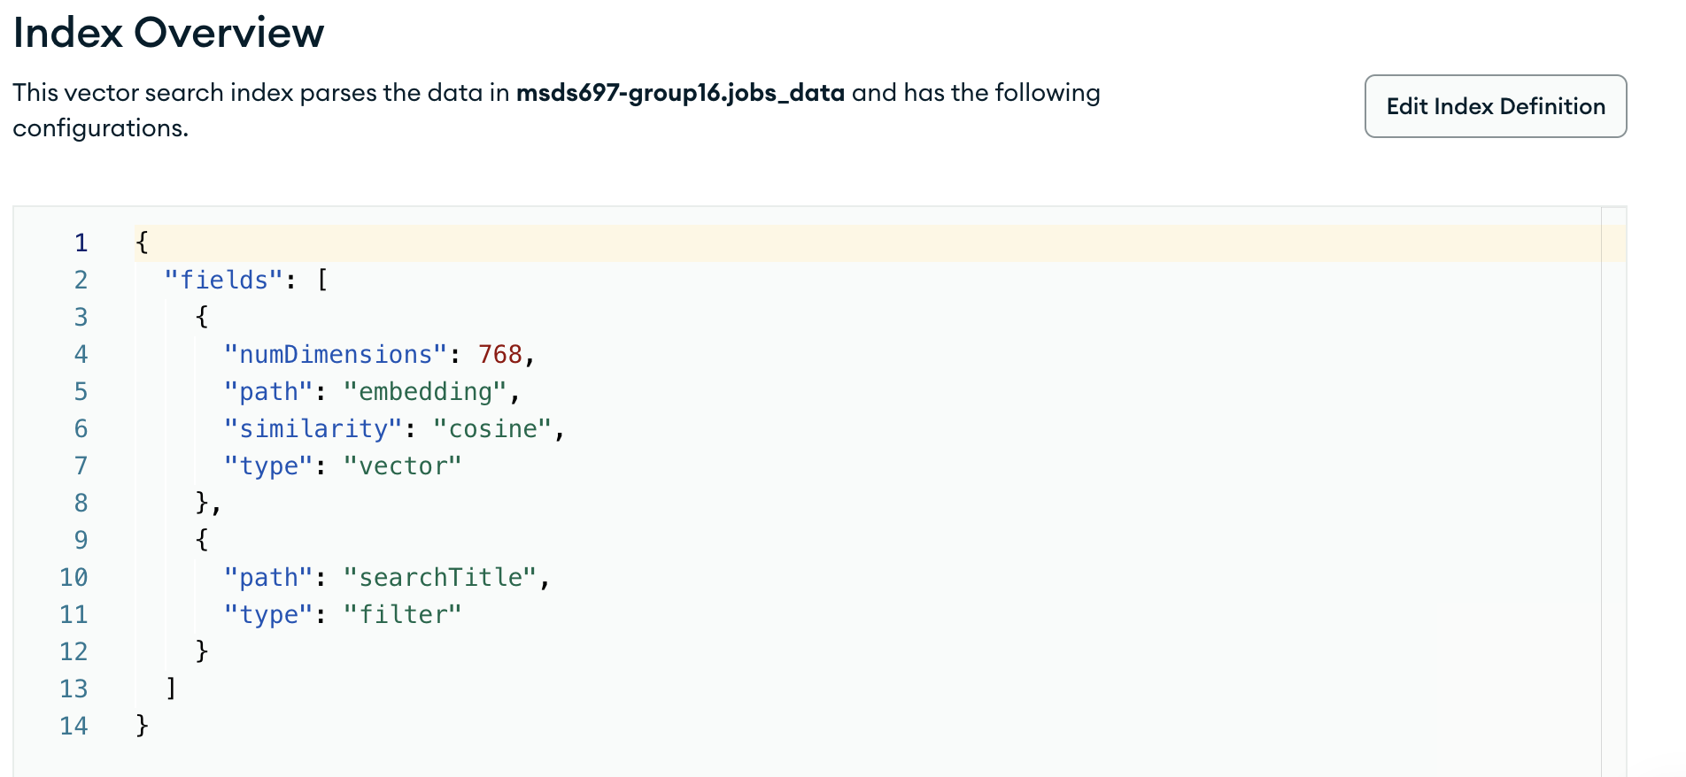
Generating the recommendations
To determine the closest jobs to display
Use the embeddings key
Filter on job title
Run cosine similarity

Slide 16
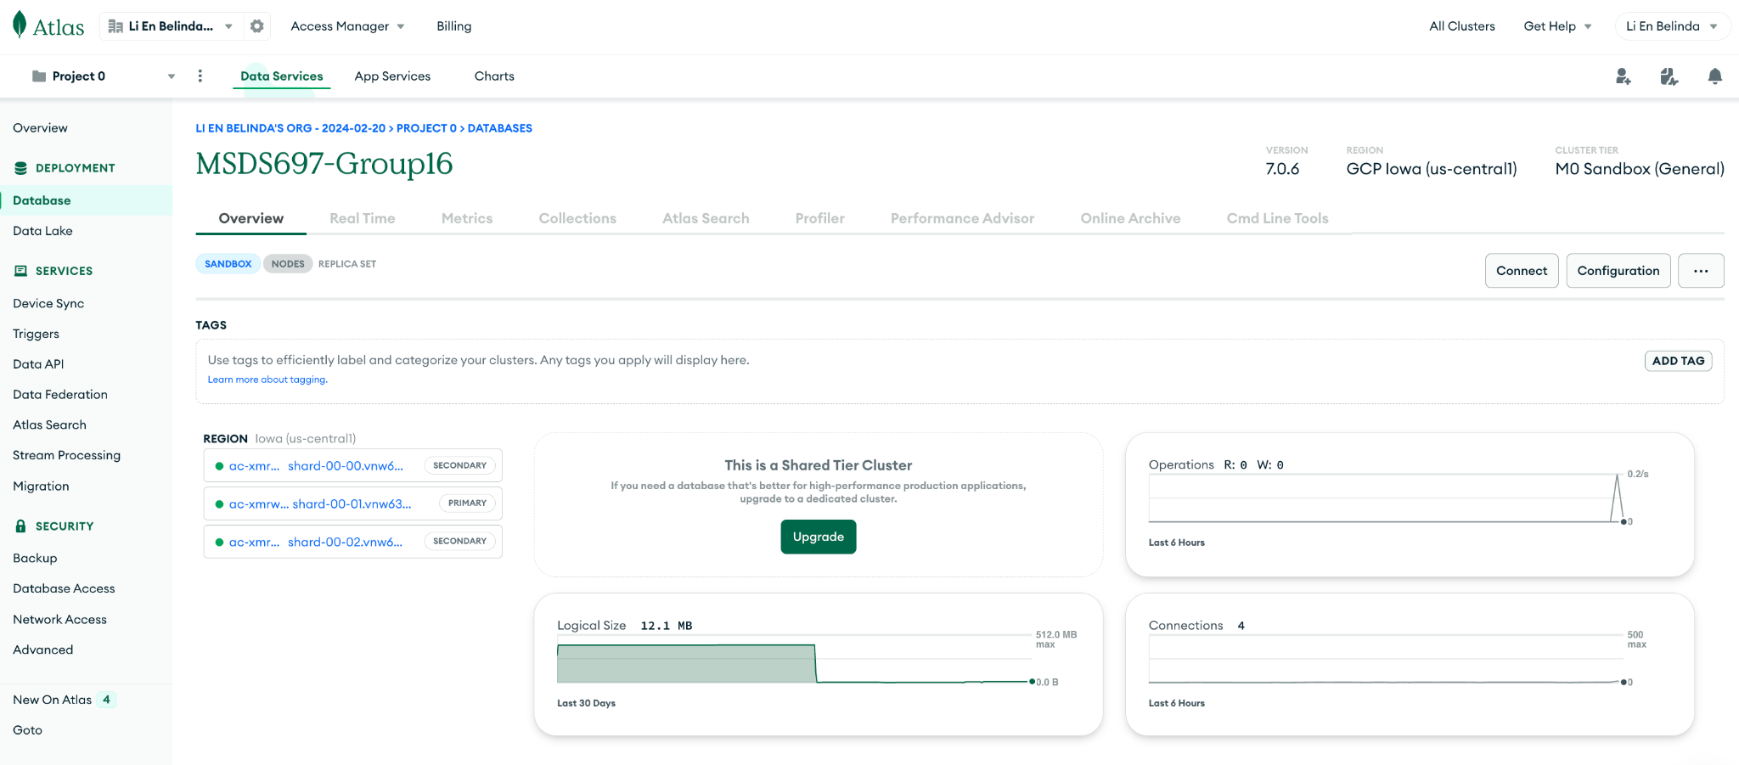
Usage of MongoDB
Notes:
Front end through Python

